Slide 1
Way To Fly: Airline Reservation System
PUNS AIRWAYS: Airline Reservation System
By-
Priya Gianchandani (10672392)
Nisarg Virvadia (10672404)
Susan Palliparambil (10672538)
Udit Bhatia (10672363)

Slide 2
Abstract
PUNS Airways is a Single Page Airline Reservation web application which provides a user-friendly Interface and an easy efficient way to search and book flight tickets.
This application is currently working for a single airline company and only for domestic flights.
User have access to search flights and apply for it. User can register on website to search for flights and book tickets.
It also gives the functionality to ADMIN to ADD and Delete the particular flight.

Slide 3
Technologies Used
ANGULAR8 FRAMEWORK
SQL Server Management Studio V18.6
ASP.NET WEBAPI
POSTMAN

Slide 4
Required Modules
ADMIN MODULE
Admin Module
Admin Login
Add & Delete Flight
Login
Register
Flight Search
Flight Select
Payment
USER MODULE

Slide 5
Implemented Modules
ADMIN MODULE
ADMIN LOGIN
ADD & DELETE FLIGHT
USER MODULE
LOGIN
REGISTER
FLIGHT SEARCH
FLIGHT SELECT
PAYMENT

Slide 6
Implemented Modules Continued :
CANCEL FLIGHT
FORGOT PASSWORD

Slide 7
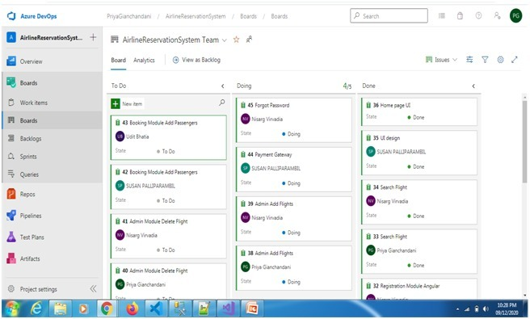
SCRUM BOARD
Source- dev.azure.com

Slide 8
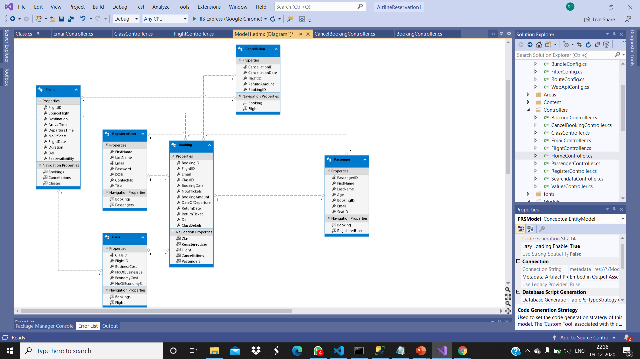
Database Design

Slide 9
Screenshots of All the Modules
Screenshots of All the Modules

Slide 10
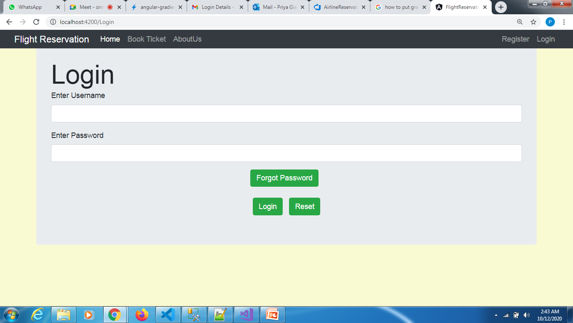
User-Login

Slide 11
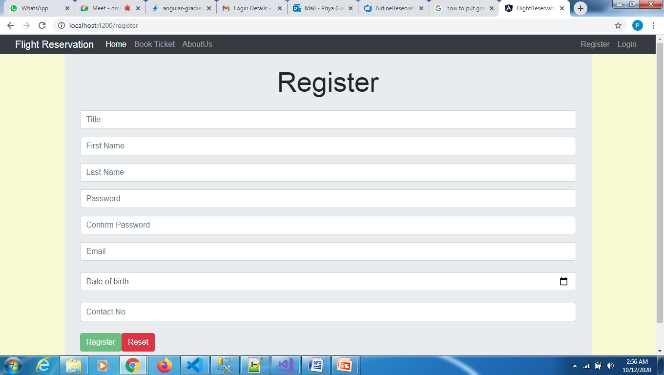
User-Registration

Slide 12
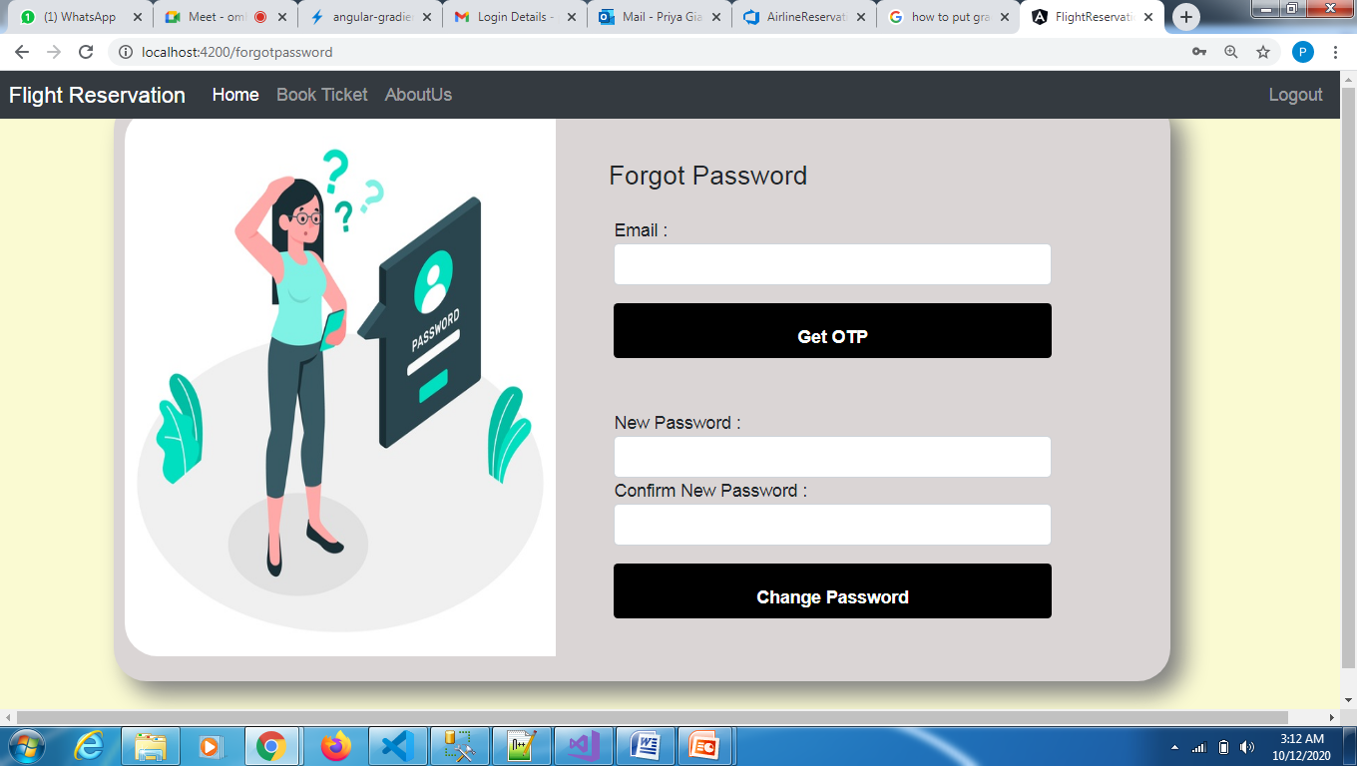
Forgot Password

Slide 13
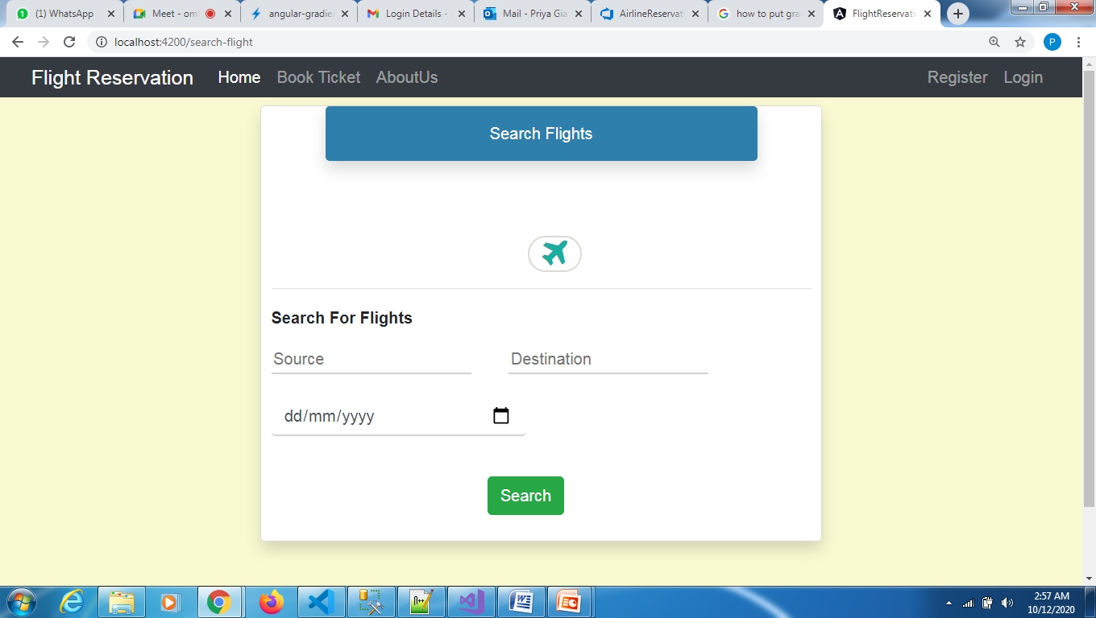
Flight-Search

Slide 14
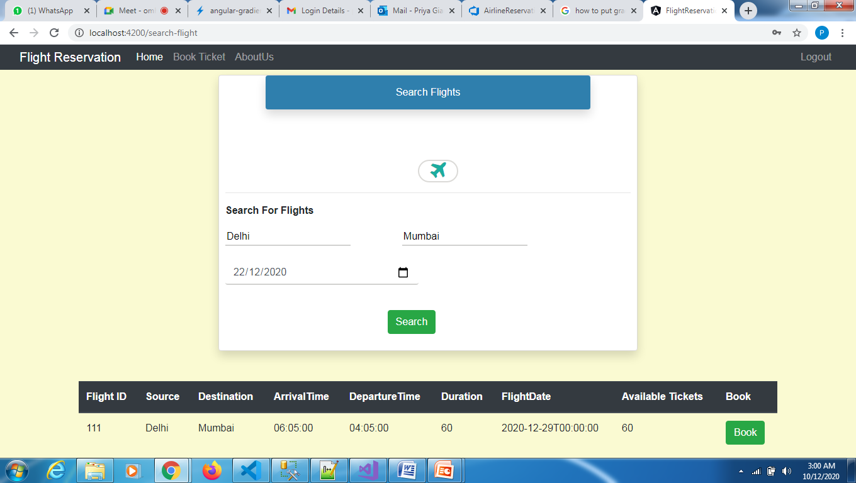
Flight-Select

Slide 15
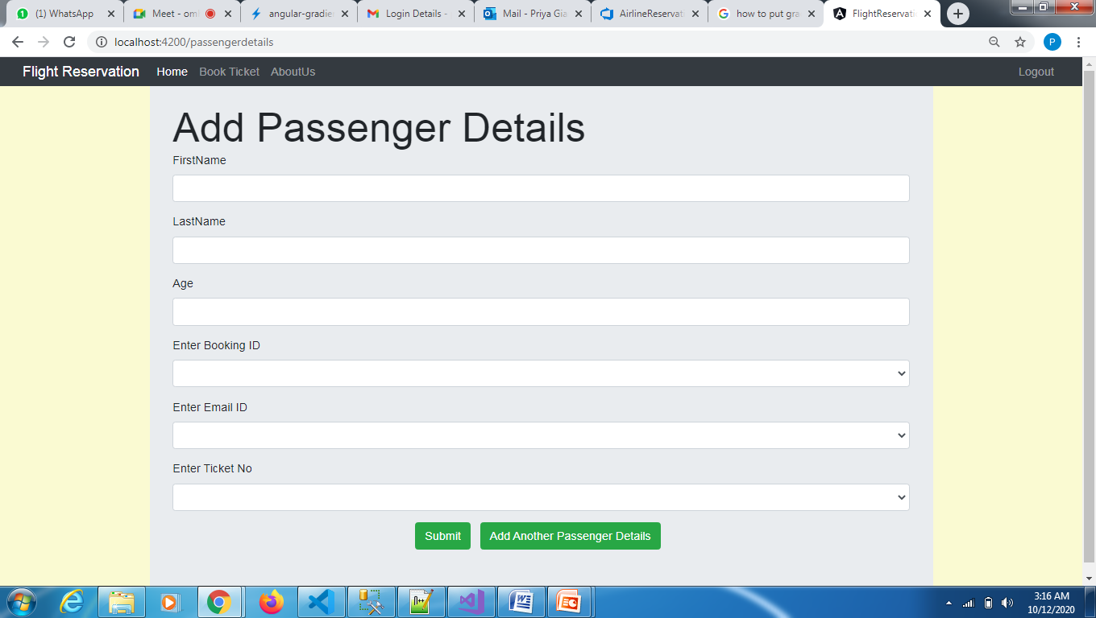
Passenger-Details

Slide 16
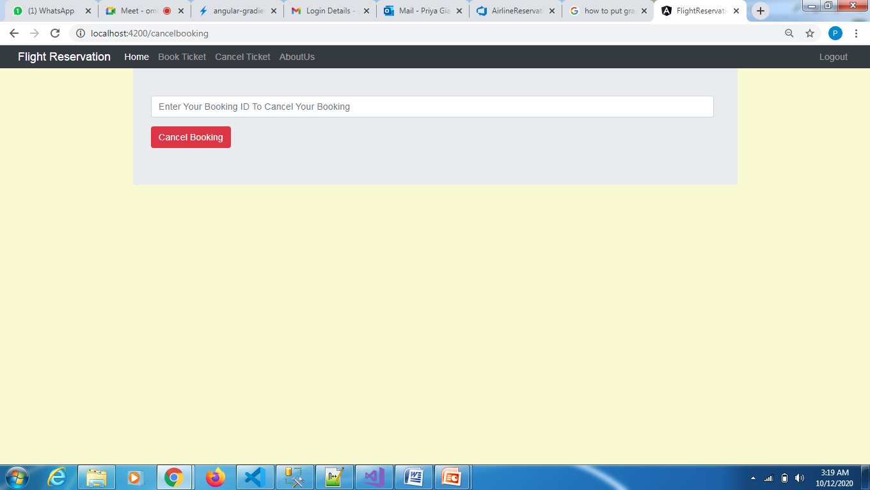
Cancel-Booking

Slide 17
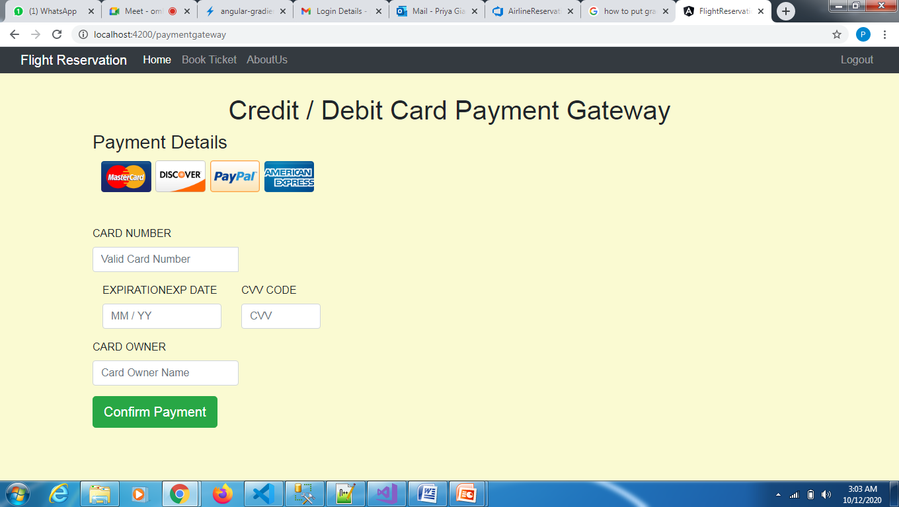
Payment

Slide 18
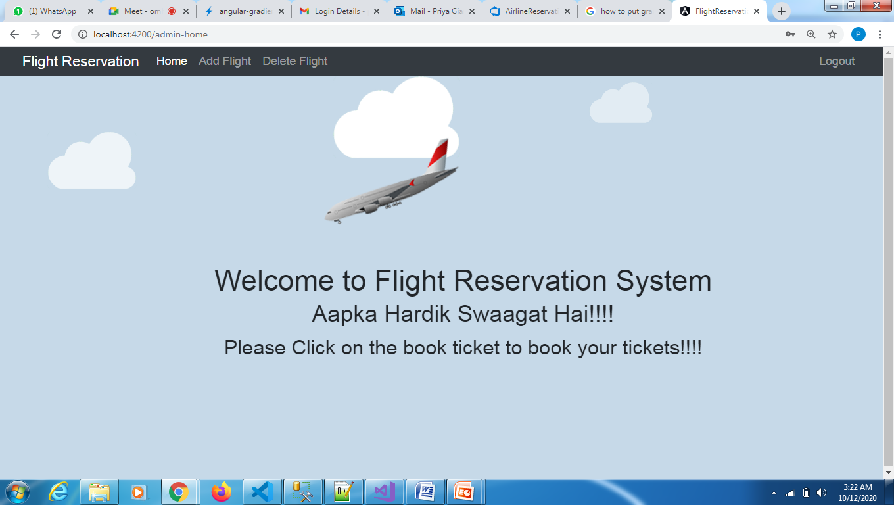
Admin Login

Slide 19
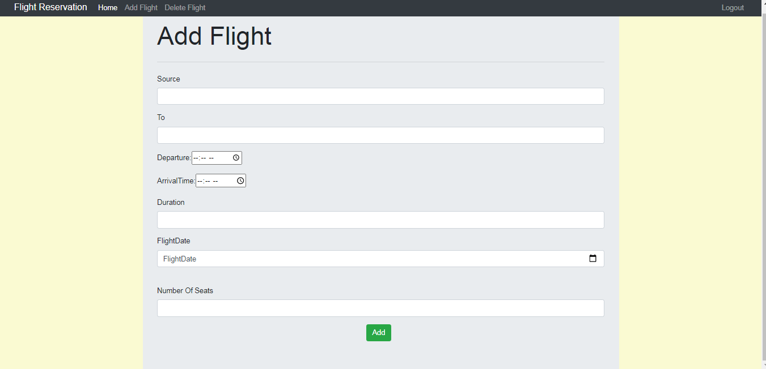
Add Flight

Slide 20
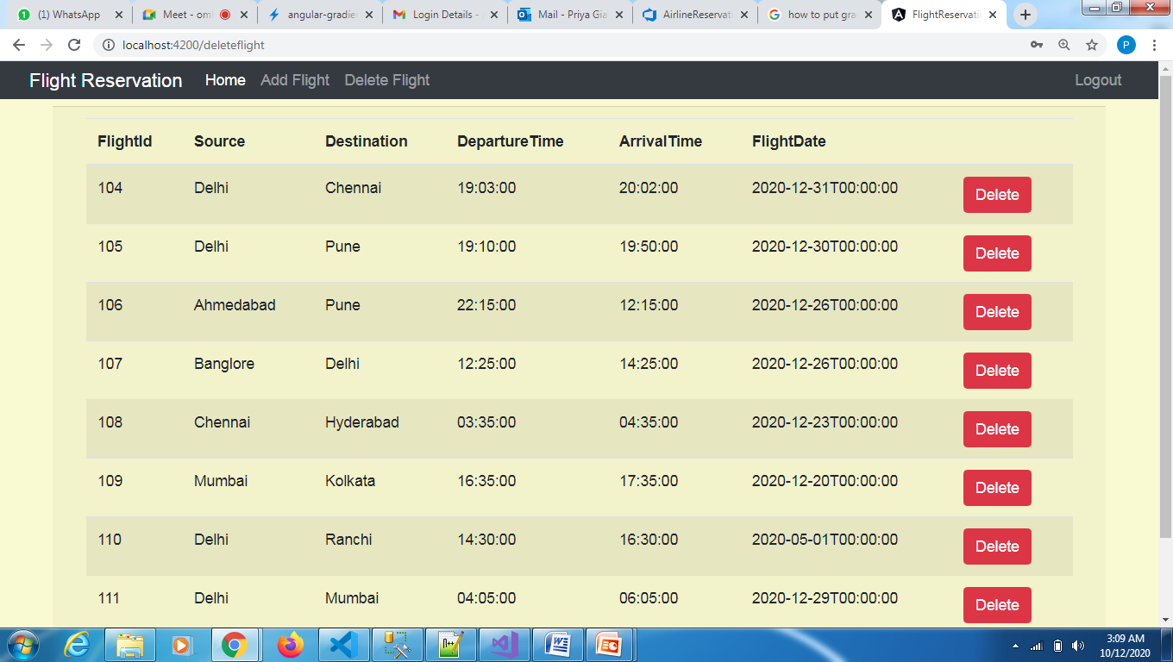
Delete Flight

